Slide 1
Topic: Review of rates and ratios
EQ: What do we know about rates and ratios.

Slide 2
Ratios are used to compare quantities with the same units.
The ratio of 2 to 5 is written as 2 : 5
If there are 15 green cars, 3 red cars and 4 blue cars
a) what is the ratio of blue cars to green cars?
b) What is the ratio of red cars to green cars?
c) What is the ratio of blue cars to total cars?
A toy company makes 6 rubber ducks and 5 dolls to every 2 toy drill.
a) Write this in a ratio of drills to ducks
B) drills to ducks to dolls
C) dolls to total

Slide 3
The trick with simplifying ratios is to always multiply or divide the numbers by the same number.
Eg 1) 25:15 2) 0.6:0.7
5:3 6:7
÷5
÷5
X10
X10
Simplify a) 12:24 b) 36:18 c) 8:102
5) The ratio at a conference is 2 girls to every 3 boys, how many girls are there if there are 120 boys?
6) If a blend of coffee requires 3g of arabica beans to 4g of robusta, How many grams of arabica do I need if I use 48g of robusta and what is the total weight?

Slide 4
Think of a ratio in terms of parts. A ratio of 2 : 3 has a total of 5 parts.
To split a number by a ratio use the following procedure:
Find the total number of parts in the ratio.
Find the value of one part.
Find the valve of the number of parts.
Eg. Spilt 200 apples in a ratio of 3:5:12
3:5:12 has 3+5+12 = 20 parts
200 apples ÷ 20 parts = 10 apples per part
30:50:120 (check this adds to give 200)
7) Split $100 in the ratio of 4:6
8) A class has 32 students in a ratio of 7 boys : 9 girls. How many boys are there?
9) Marco owns 30% of a company, Julia owns 60% and Julio owns 10%.
a) write this as a ratio
b) the company earns $10,000 profit on a contract. How much does each person get?

Slide 5
A rate compares items with different units.
km/hr $/hr $/kg L/min beats/min goals/game
Write the following as rates
a) driving 450km over 9 hours
b) getting paid $150 for 6 hours work
c) Filling a 9 litre bucket in 30 seconds
d) Scoring 90 pts over 5 games of basketball
e) Writing 1200 words over 60 minutes

Slide 6

To find the rate we need to work out what one of that unit will be.
To do this we need to divide both numbers by the second number
Now simplify the following as rates with the units in the brackets
a) driving 450km over 5 hours (km/hr)
b) getting paid $150 for 5 hours work ($/hr)
c) Filling a 9 litre bucket in 2 minutes (l/min)
d) Scoring 110 pts over 5 games of basketball (pts/game)
e) Writing 1800 words over 2hours (words/min)
f) 3kg of apples for $15 ($/kg)

Slide 7
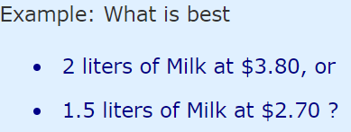
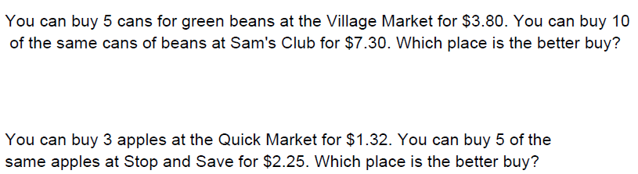


Comparing Unit Prices can be a good way of finding which is the "best buy"
$$=\$1.90 per Litre$$
$$=\$1.80 per Litre$$

Slide 8
Find a percentage of an amount.
Divide the percentage by 100 and multiply by the amount.
Eg, to find the 20% of $250;
20% ÷ 100 x 250
= 0.2 x 250
= $50
Eg, to find the 90% of 330 apples;
20% ÷ 100 x 330
= 0.9 x 330
= $297
Try and answer these on your LHS.
Find
a) 30% of 90 b) 5% of 220 c) 9% of 189 d) 108% of 220
If 15% of a batch of 450 apples are rotten, how many apples are rotten?
If 21% of people have blue eyes, how many would you expect out of 1,500 students?

Slide 9
To increase an amount by a percentage…
find the percentage of the amount
Add it to the original amount.
Eg increase $210 by 10%
10% of $210 = 10 ÷ 100 x 210
= $21
Increasing $210 by 10% is therefore $210 + $21 = $231
Eg This years crop of apples is 22% bigger than last years 3000kg.
22% of 3000 = 22 ÷ 100 x 3000
= 660kg
increasing 3000kg by 22% is therefore 3000kg + 660kg = 3660kg
LHS – try the following
increase the following by the percentage
a) $150 by 50% b) 110g by 20% c) 20km by 80%

Slide 10
To Decrease an amount by a percentage…
find the percentage of the amount
Take it away to the original amount.
Eg decrease $45 by 10%
10% of $45 = 10 ÷ 100 x 45
= $4.50
decreasing $45 by 10% is therefore $45 - $4.50 = $40.50
Eg A $90 pair of jeans are discounted by 25%.
25% of 90 = 25 ÷ 100 x 90
= $22.5
decreasing $90 by 25% is therefore $90 + -$22.50 = $67.50
LHS – Now try to decrease the following.
Decrease the following by the percentage
a) $150 by 50% b) 110g by 20% c) 20km by 80%

Slide 11

Profit and Loss
1. First find your profit or loss.
sell price – cost price = profit or loss (negative means loss, positive means profit)
2. Then find the percentage profit or loss
$$\% Profit (or loss)= \frac{Profit (or loss)}{cost price}×100$$
Find the percentage profit or loss for the following.
Basketballs cost $2.75 to make and are sold for $27.50
A house is sold for $510,000 5 years after being bought for $550,000
A socks are bought at $5 per pair are on-sold at $5.75.

Slide 12
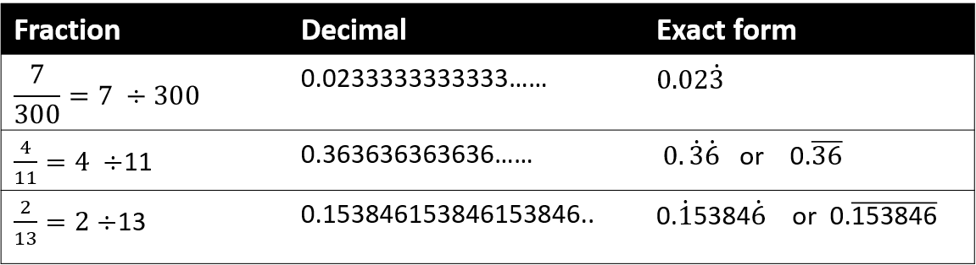




Some decimal numbers are recurring and some are recurring (repeating endlessly). When we have recurring decimals we can use “Exact” form.
Are the following recurring or terminating? Use exact form where necessary.
$$a) \frac{1}{5}=$$
b$) \frac{5}{6}=$
c$) \frac{3}{7}=$
d$) \frac{6}{13}=$

